Slide 1

Meet-up App
Requirements Engineering Project (M24)
Presented by:
Mohit Kokate : S0585841 Yash Revannavar : S0586034
Aditya Kumar : S0586035
Nikhil Amin : S0585844
Pramod Shirale : S0586040

Slide 2
Introduction
Platform for individuals or groups to organize, discover, and participate in various events, activities, or gatherings.
Enables people with common interests to connect and meet in person.
Event Creation and Management.

Slide 3
Stakeholder
Type of Features:
Management Board
Customer
Developer
Stock, shareholders/ Investors
Product owner
Project manager
Legal department (data protection)

Slide 4
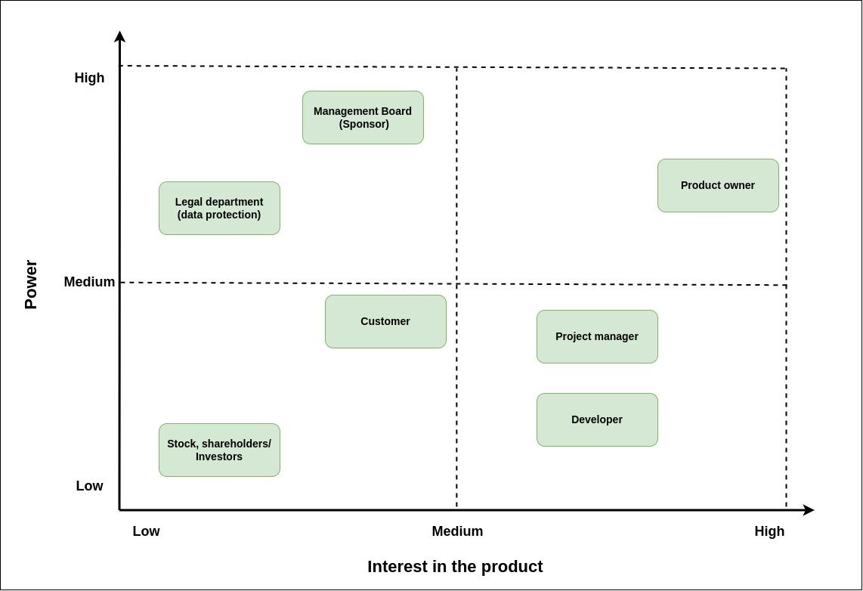
Stakeholder

Slide 5
Requirements (Technical)
Frontend: HTML, CSS, JavaScript
Backend: Node.js, Ruby on Rails, Django, Java Spring, ASP.NET, Quick (iOS), Kotlin (android), etc
Databases: MySQL, PostgreSQL, MongoDB, Redis, etc.
Integrations: Email service provider, Search engine Elasticsearch, Google Maps API), Calendar library, Firebase Cloud, Messaging Notification Hardware requirement: iOS v14, Android v10, Windows v10
Notes:
- These technical specification requirements(TSD) provide a broad overview of the various aspects that need to be considered when developing a Meetup application.
Platform/Technologies: Specify platform(s) the application will run on (e.g., web, mobile, both).
- Identify programming languages, frameworks, libraries, databases to be used.
User Interface: user-friendly, easy navigation and interaction, responsive, compatible with diff. devices, screen sizes User Mngt: user registration, login functionality, user profile,
Meetup Events: creating, editing, and deleting meetup events, search based on filters, Notifications and Reminders: system to send reminders and updates to users about upcoming meetup events, push notification service Meetup Groups: users to create, join, and manage meetup groups, do not exceed the maximum capacity, Meetup Reviews/Ratings:
Integration: mapping services to disp event loc, directions information for meetup events to users.
- social media sharing, integration for users to share events, invite friends.
- with third-party services like payment processing or ticketing.
Security: secure user authentication mechanisms, like encryption, hashing of passwords.
- secure communication between the application and users, using HTTPS or other secure protocols. - apply proper authorization and access control to protect user data and prevent unauthorized access.
Deployment and Maintenance: Define the deployment process, including server configuration and hosting requirements.
- Plan for regular maintenance and updates to ensure the application remains secure and up-to-date. Requirement Tracing Matrix: establishing traceability between the technical requirements and the requirements for the product.

Slide 6
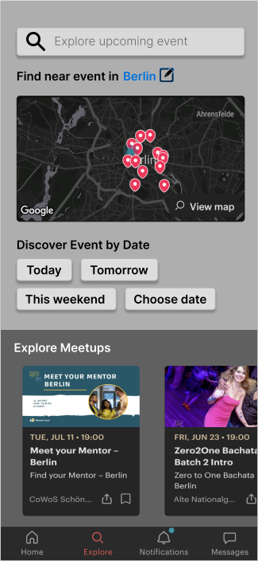
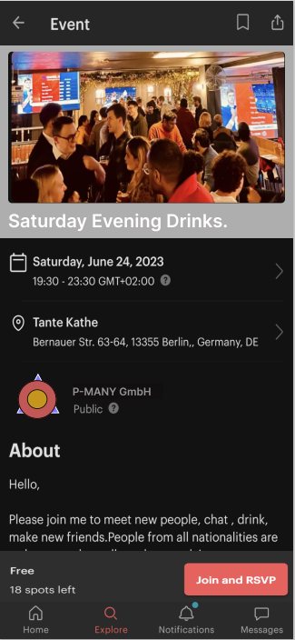
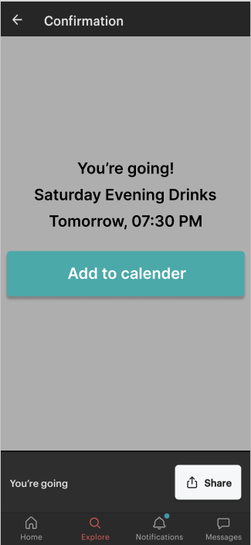
UX Design

Slide 7
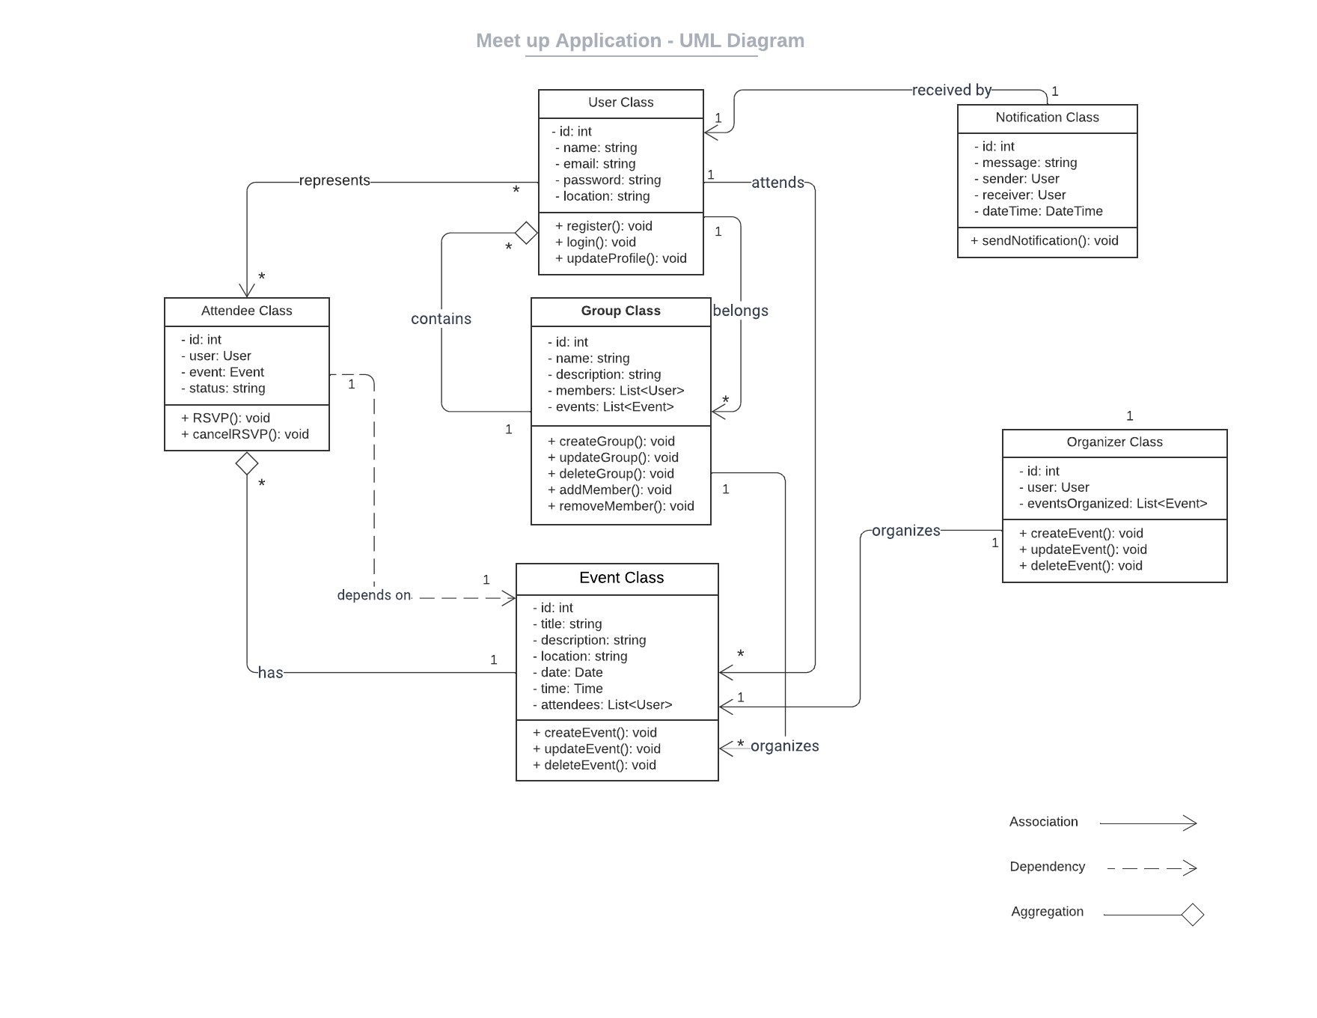
UML - Class Diagram
Notes:
- The User class has a one-to-many association with the Event class, indicating that a user can create or participate in multiple events. - The User class has a one-to-many association with the Group class, representing that a user can create or join multiple groups. - The User class has a one-to-many association with the Attendee class, indicating that a user can be registered for multiple events as an attendee. - The Event class has a many-to-one association with the Group class, representing that an event belongs to a specific group. - The Event class has a one-to-many association with the Attendee class, indicating that an event can have multiple attendee. - The User class has a one-to-many association with the Notification class, representing that a user can receive multiple notifications. - The Organizer class has a one-to-many association with the Event and Group classes, indicating that an organizer can create or manage multiple events and groups.

Slide 8
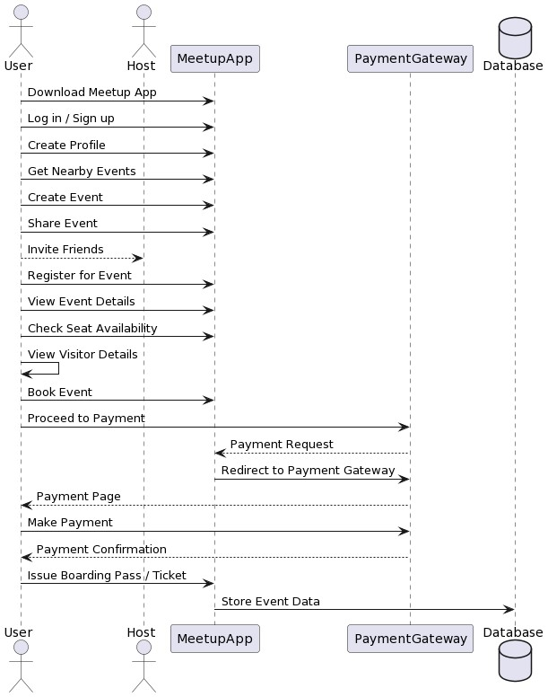
UML - Sequence Diagram

Slide 9
Features
As a user
Search for Meet-ups
Join a Meet-up
Filter Meet-ups as per location, date, interests
Chat with the host and other users
As a host
Create a Meetup Event
Add Name and short description of the Meetup
Select Venue, Date and Time of the Meetup
Select the limit on the number of people (optional)

Slide 10
Features
Additional Features
Interest-based Matching
Group Formation
In-app Ticketing and Payment
Gamification Elements
Unique Features
Chat with the chatbot
Use of AI to analyse the user behaviour and notify relevant events
Create avatar of users
Attend the event through AR/VR technology

Slide 11
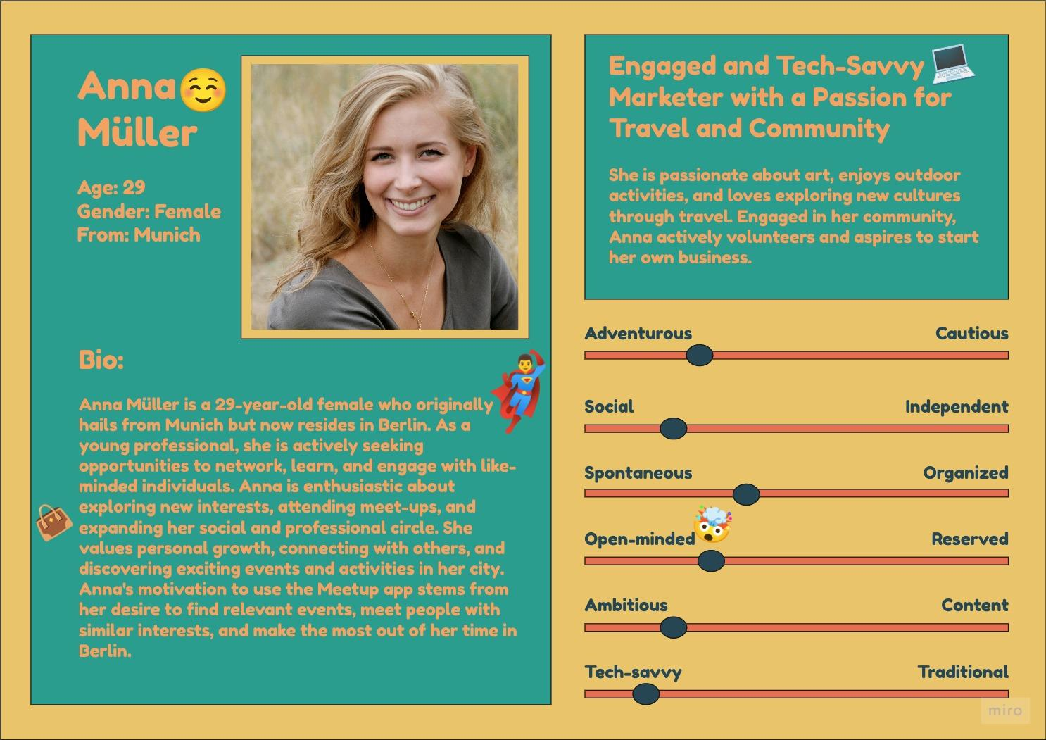
User Persona

Slide 12
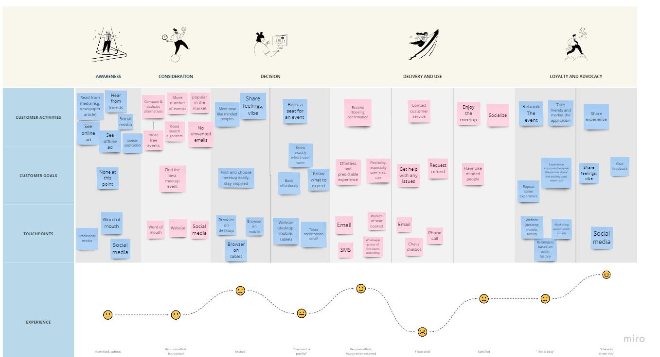
Customer Journey map

Slide 13
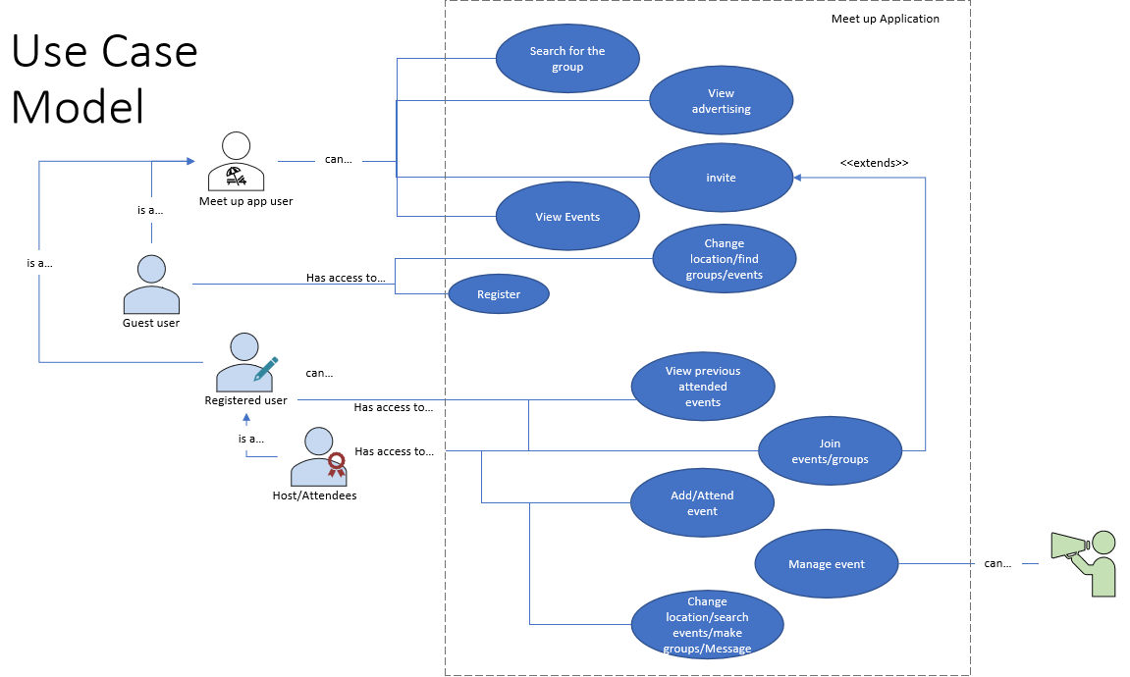
Use cases

Slide 14
Quality
Maintaining the quality of the application is the key point. Perform thorough testing of all features and functionalities to ensure proper functionality and usability. Conduct security testing to identify and address any vulnerabilities.
Manual testing strategy: Functional testing, Sanity testing, smoke testing, Retesting, Interrupt testing, Notification testing, Regression testing.
Automation testing strategy: Appium, Java, Espresso testing framework.
Security testing strategy: Mobile Security Framework (MobSF), pentesting, malware analysis, and both static and dynamic analysis
Notes:
Network testing , compatibility testing, phone is on charging, application killed

Slide 15
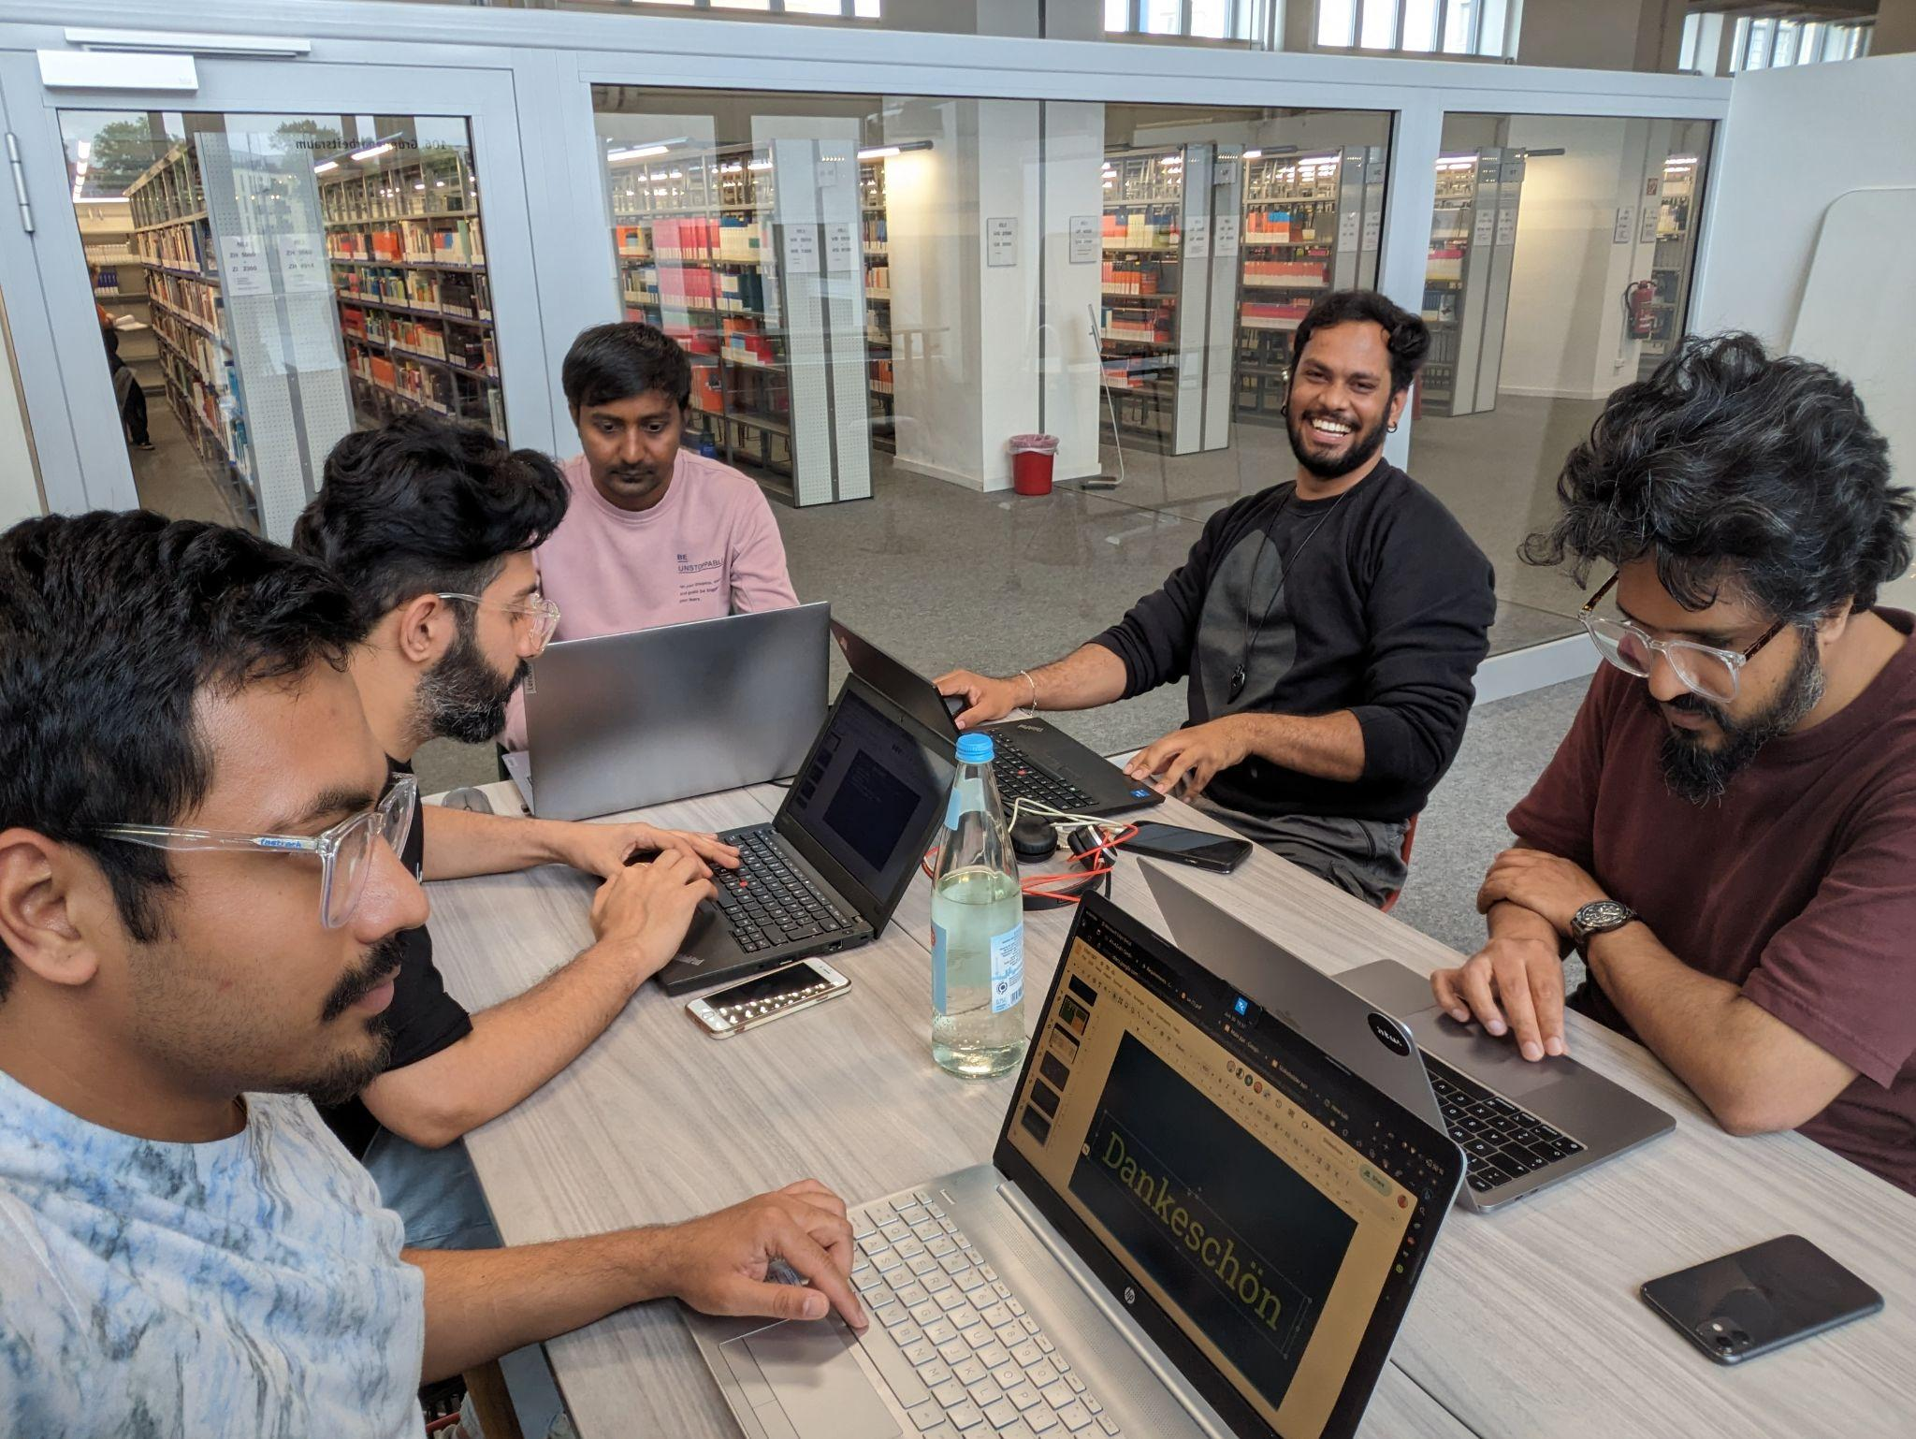
Thank you!

